Slide 1
UAS Alert
Final Design Presentation

Slide 2


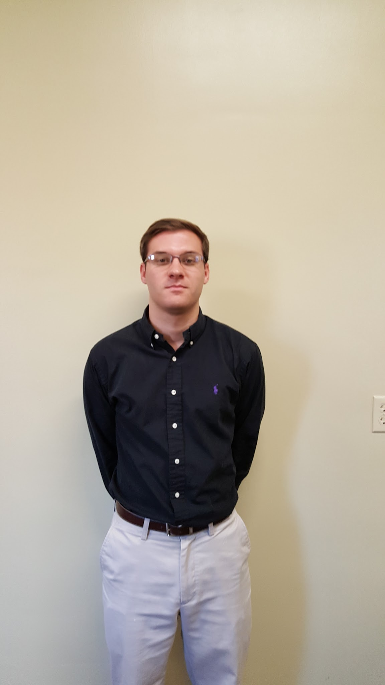


Team Members
Brian Joyner
Carter Long
Clayton Hudspeth
Brady Wade
Chase Abercrombie
Computer Engineering
Electrical Engineering
Electrical Engineering
Electrical Engineering
Electrical Engineering
Notes:
wbw

Slide 3

Advisor
Dr. J.W. Bruce
Associate Professor
Mississippi State University
Ph.D., Electrical Engineering, University of Nevada Las Vegas, 2000
M.S., Electrical Engineering, Georgia Institute of Technology, 1993
B.S., Electrical Engineering, The University of Alabama in Huntsville, 1991
Notes:
wbw

Slide 4
Teaming
 | Website | Power Supply Design | Compact Design | PCB Design | Embedded & Display Software
Brian Joyner | ✔ |  |  |  | ✔
Clayton Hudspeth | ✔ |  |  |  | ✔
Brady Wade |  | ✔ |  | ✔
Chase Abercrombie |  | ✔ | ✔ | ✔
Carter Long |  | ✔ |  | ✔
Notes:
wbw

Slide 5
Agenda
Problem and Solution
System Overview
Constraints
Practical
Technical
System Testing
Progress
Timeline
Future Work
Questions

Slide 6
Problems & Solutions

Slide 7
Problem Statement
During a nine month period, November 2014 to August 2015, the FAA reported 764 UAV sightings where the UAV compromised the safety of the aircraft [1].
UAS operators do not have to go through any safety training or certification before being allowed to operate a UAV.
Recent FAA rules allow for a UAV to fly above 400 ft. through a waiver application.
Notes:
wbw

Slide 8
Solution
Provide UAVs the ability to map and track nearby air traffic.
Create a device that can be easily attached to any UAV.
Give alerts to help mitigate the chance of mid air collisions.
Notes:
wbw

Slide 9
System Overview
Notes:
wbw

Slide 10
Constraints

Slide 11
Practical Constraints
Safety
Real time mapping
Accurate Results
Alerts to keep pilots safe
Political
Can only use ADS-B IN
Cannot broadcast on unauthorized frequencies

Slide 12
Technical Constraints
Constraint | Description
Transmission | Line-of-sight range on 900MHz and must have longer range than UAV controller
Device Weight | The on board device must weigh less than 300 g
Battery Life | The battery must last longer than 1 hr
Compact Design | The device must have at max these dimensions 150x150x100 mm
Response Time | UAS’s response time must be less than 1 min

Slide 13
System Testing

Slide 14
System Testing
Signal Strength and range of transceivers
Device Weight
Battery Life
Forwarding of Data
Notes:
clayton

Slide 15
Transceiver Signal Testing
Tested at multiple distances
Minimal obstruction
Test was done with packet size of 50 bytes
100 packets were sent and received in 2 minutes
Tested transmission range up to 3800 ft. Our constraints requires 3280 ft.
Notes:
clayton

Slide 16
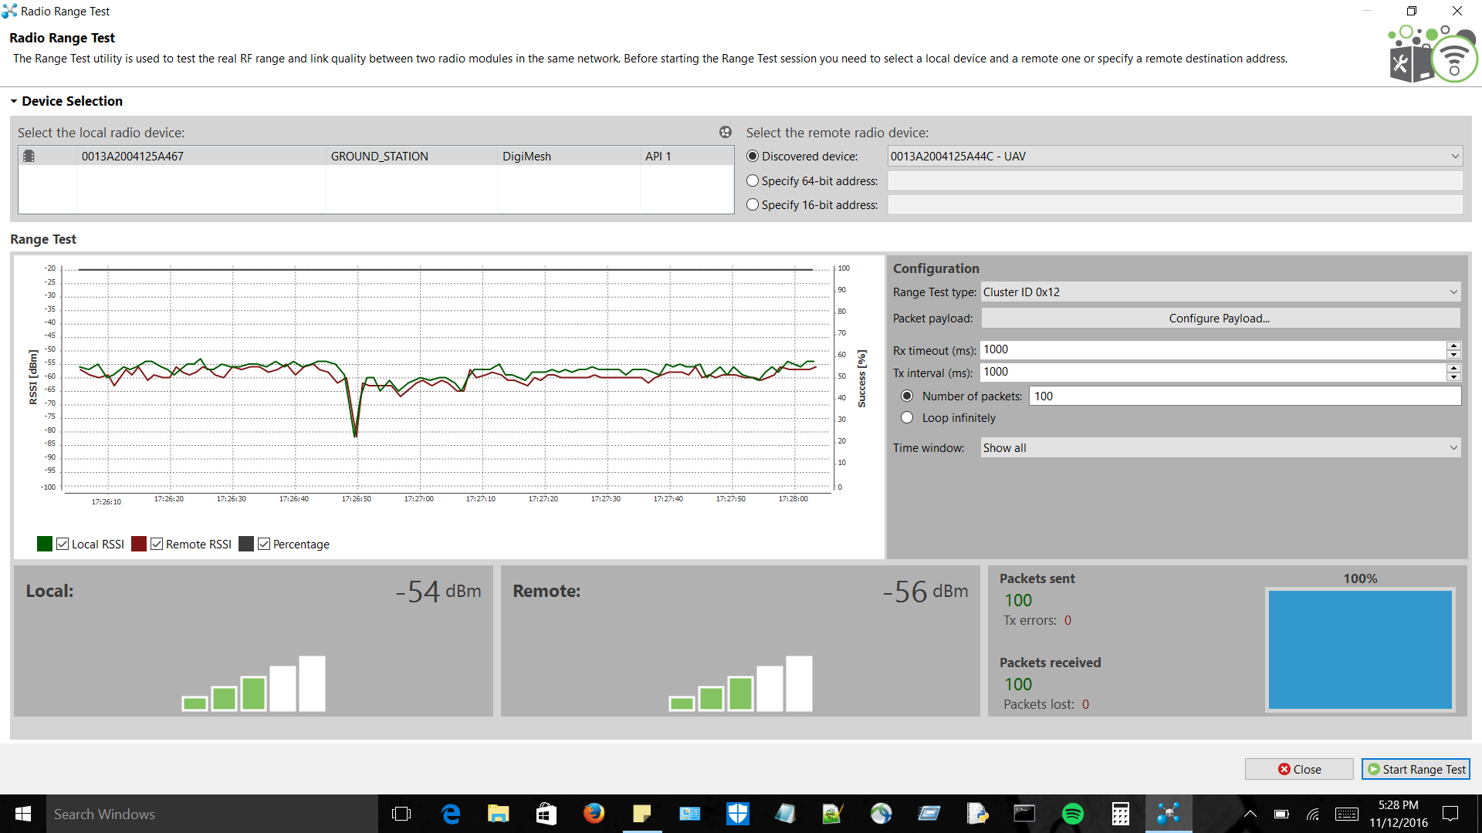
Transceiver Signal Test at 3800 ft.

Slide 17
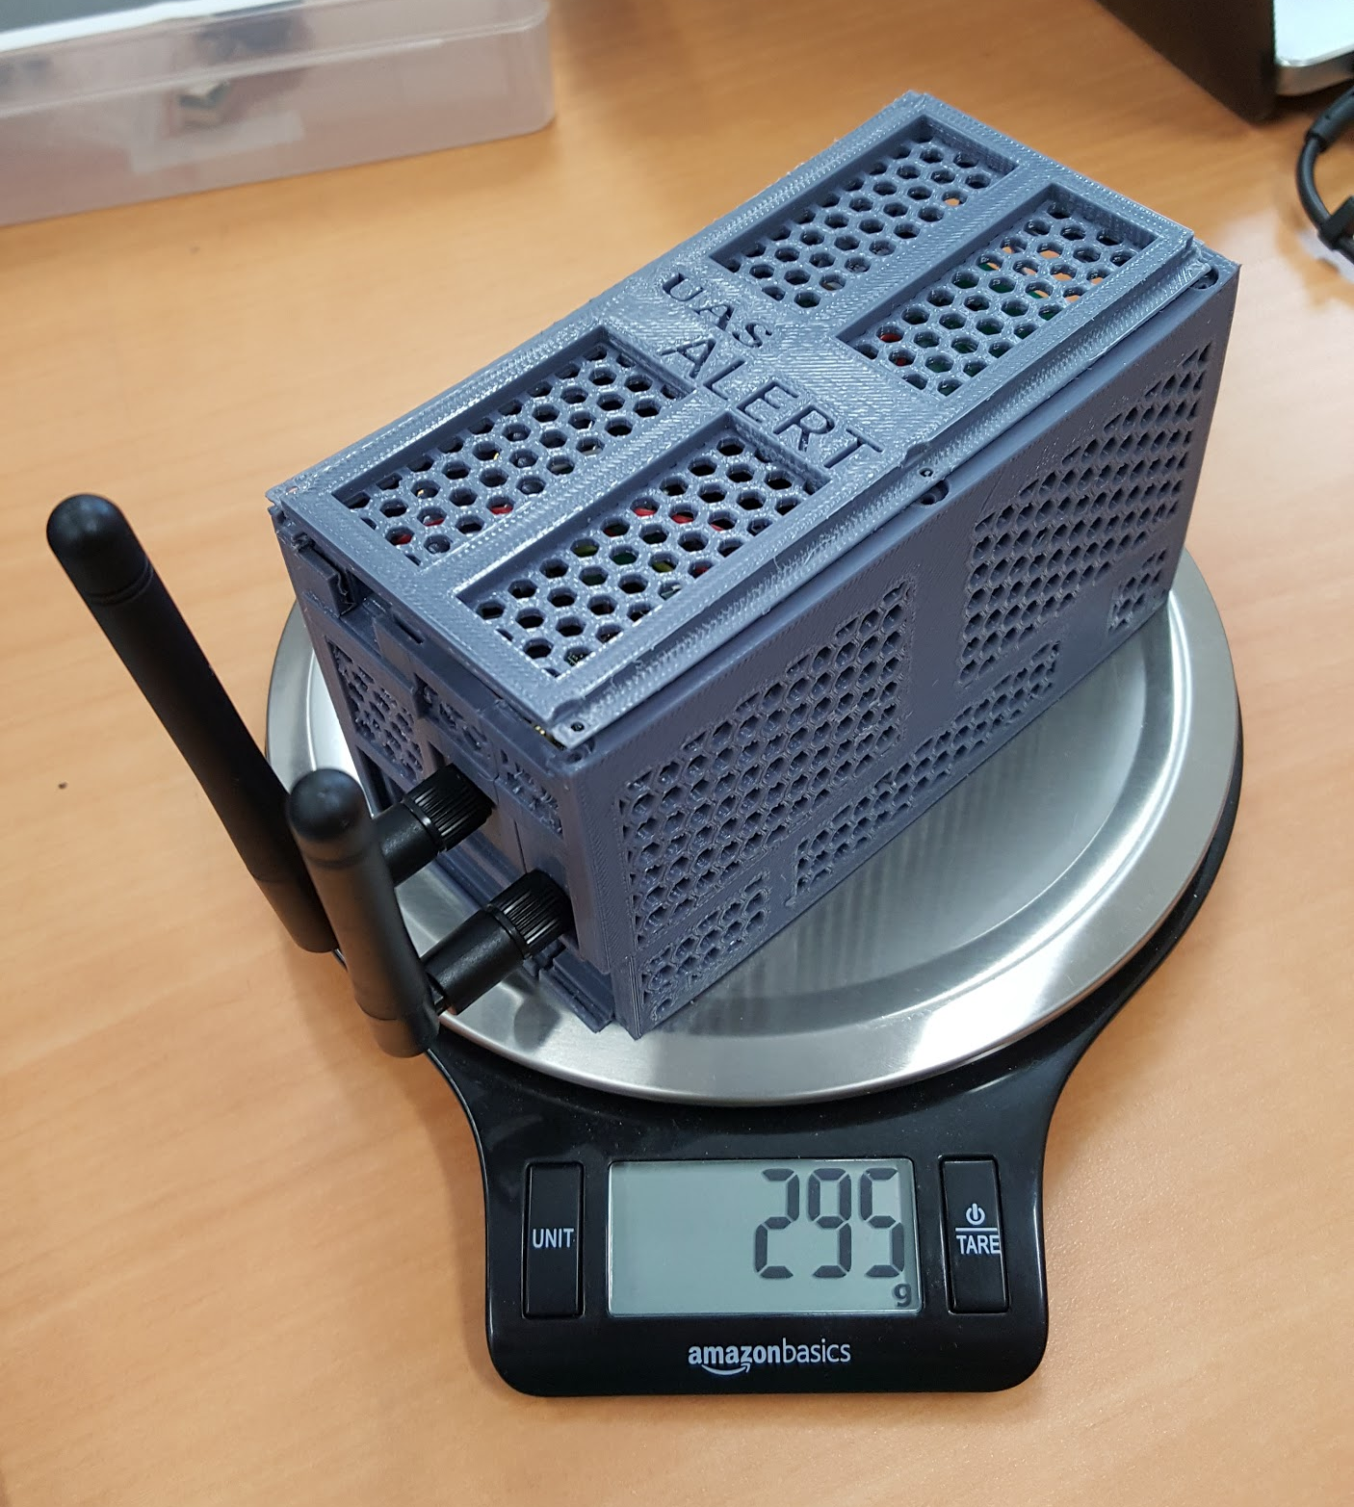
Device Weight
Component Name | Weight (grams)
Raspberry Pi 3 Model-B | 76
NooElec Nano 2 SDRs and accessories | 42
Xbee 900HP w/shield | 36
FlightPower FPRX 1600mAh | 68
UBEC DC-DC Converter | 15
Case | 58
Total Weight | 295

Slide 18
Power Supply Testing
The power supply designed to power the on-board system was tested to ensure operation for at least 1 hour.
Each component tested using in-line usb ammeter.
Current draw tested over 10 minute interval using digital multimeter and real-time sampling software.
Full charge test
Notes:
clayton

Slide 19
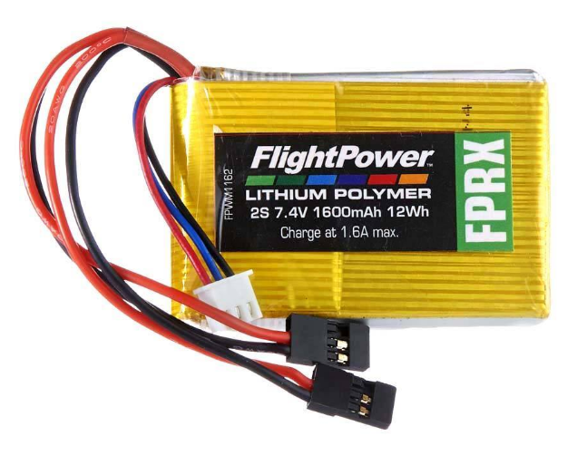
Battery
Flight Power FPRX
 | Output Voltage | 7.4 V
 | Cell Configuration | 2S (2 cells in series)
 | Charge Rate | 1 C (1*1.6 A)
 | Discharge Rate | 1 C (1*1.6 A)
 | Capacity | 1600 mAh (12 Wh)
The Battery voltage was limited to the Raspberry Pi’s required operating range of 4.5V to 5.5V. The step down in voltage resulted in a reduction in current draw on the battery.

Slide 20
Current Draw Test (USB ammeter)
Current Draw Test Results
 | Current Draw | Voltage | Power Draw
SDR (x2) | 290 mA-hr each | 5 V | 2.9 W-hr
Raspberry Pi | 400 mA-hr | 5 V | 2 W-hr
Transceiver | 215 mA-hr | 2.1-3.6 V | 0.46-0.774 W-hr
Needed | 1.195 A-hr | 5 V | 5.975 W-hr

Slide 21
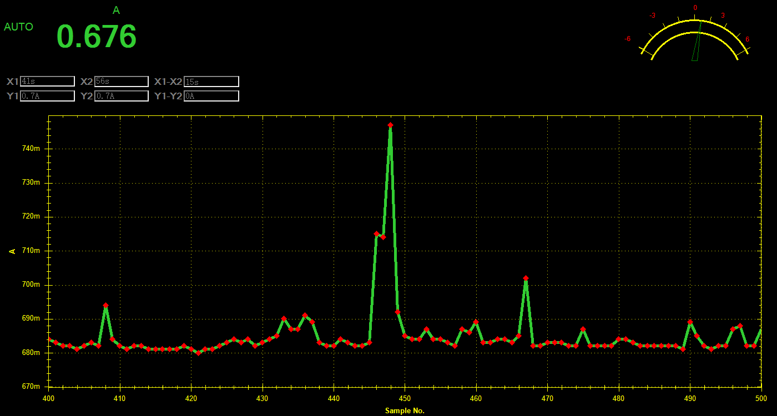
Battery Life Test
*Maximum Current Draw: 748mAh | Calculated (usb ammeter) | Measured (@ max.)
Current Draw (Ah) | 1.195 | 0.748*
Power Draw (Wh) | 5.975 | 5.532
Lasts 1hr 17mins
Battery Current Capacity: 1.6 Ah
Battery Power Capacity: 12 Wh

Slide 22
Forwarding of Data
Testing initially done with TCP
Transceivers were tested and were able to easily able to transmit a heavy payload of ADS-B messages
Simulated data sent through for testing matched the data being received and decoded
Notes:
Brian starts here

Slide 23
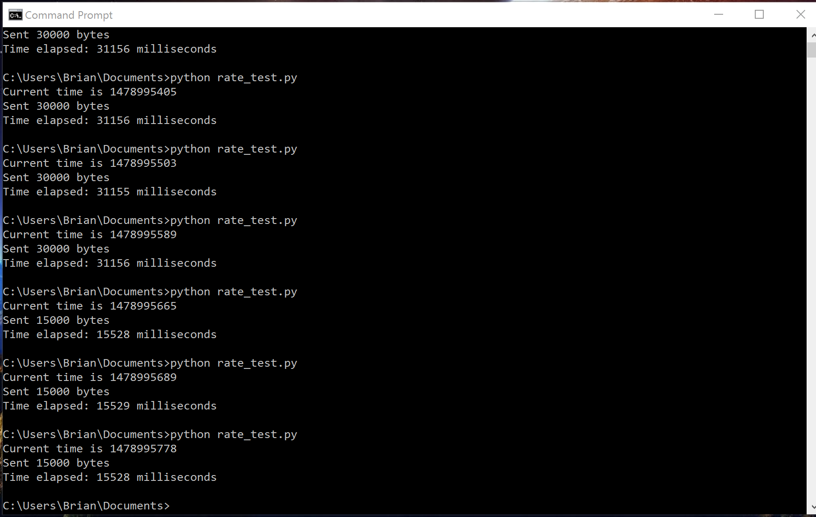
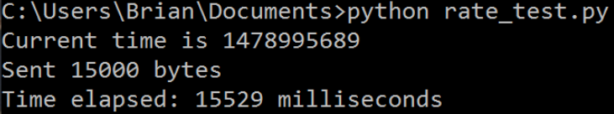
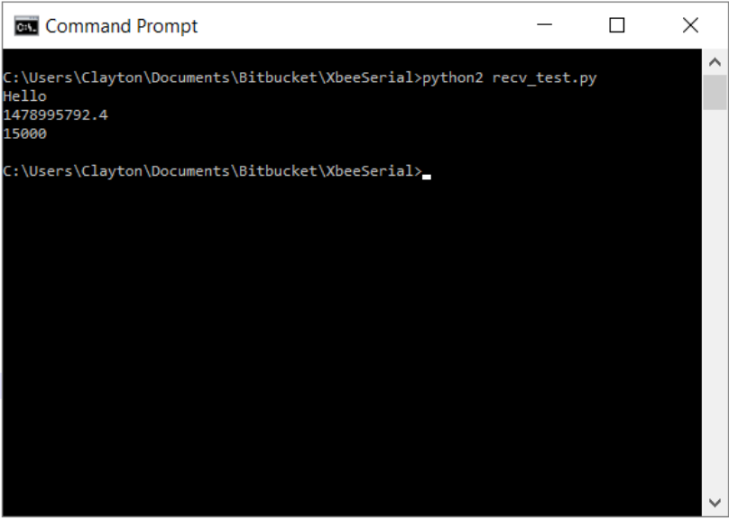
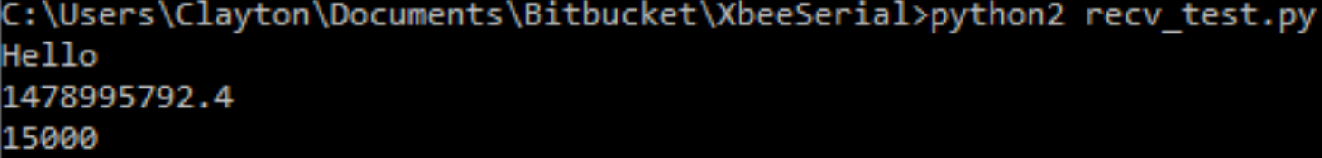
Data Rate Test at 3800ft. (15,000 bytes)

Slide 24
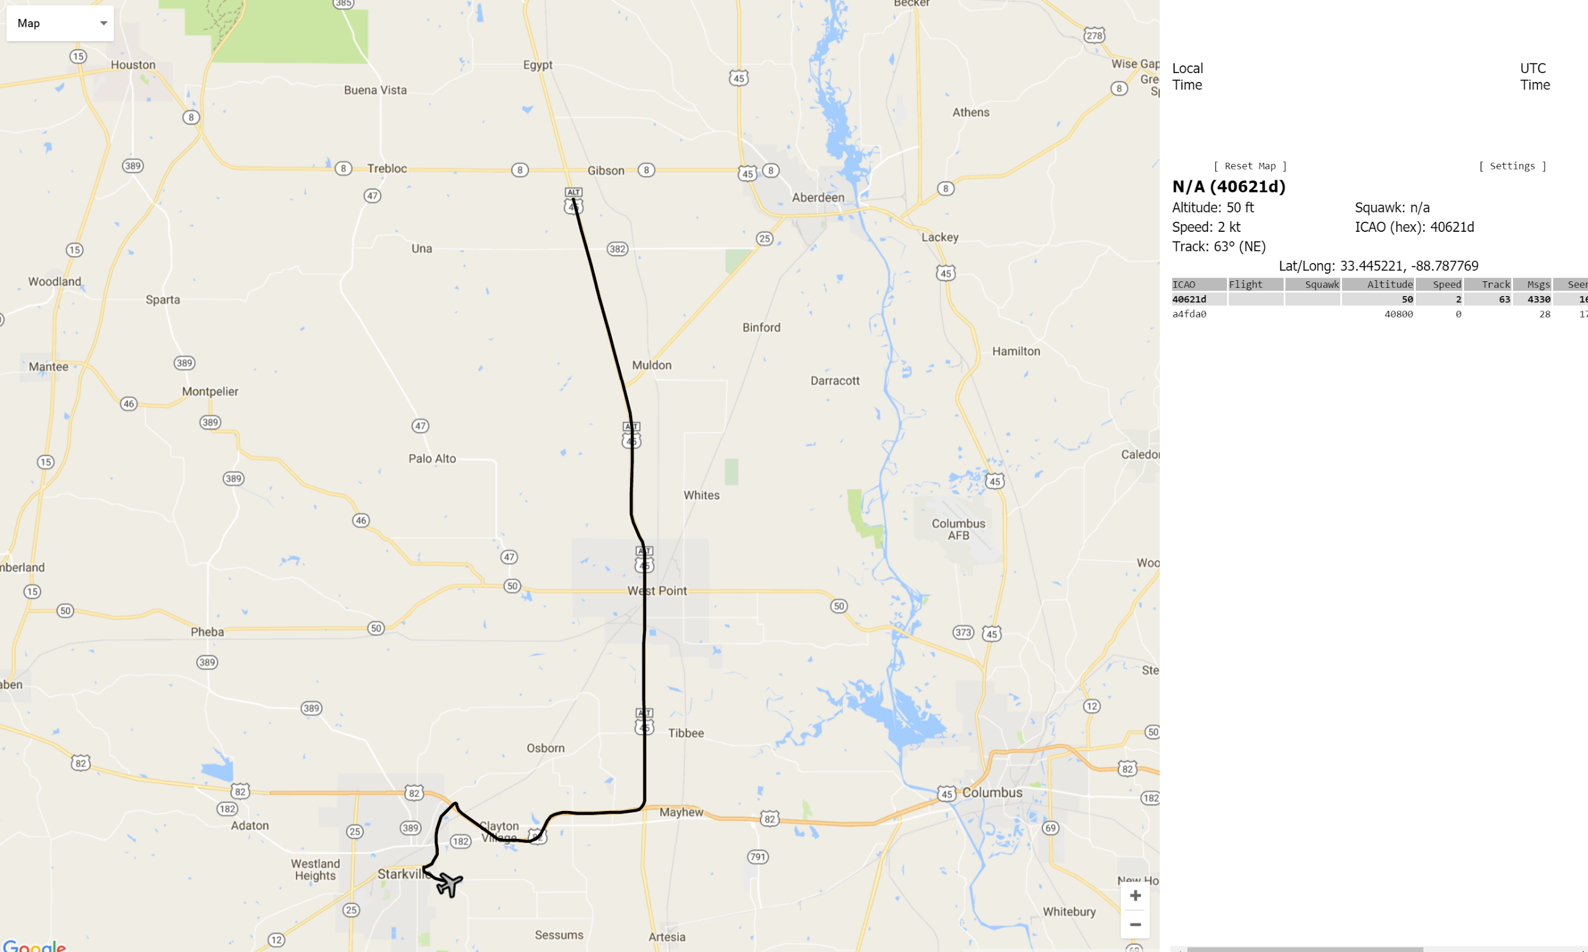
Test Trip

Slide 25
Progress

Slide 26
Progress
Able to receive ADS-B messages on 1090 and 978 and send it over the transceivers to the ground station for decoding.
Able to plot UAV using GPS data as well as nearby aircraft on the map.
PCB Fully Designed and Tested
Alerts functional with variable alert distance/altitude

Slide 27
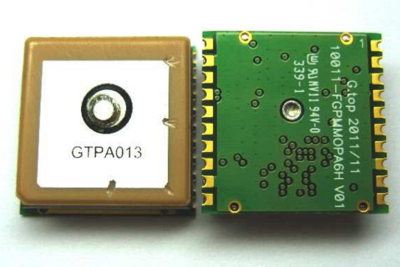
GPS (Global Positioning System)
-165 dBm sensitivity
1 to 10 Hz updates
3.3 V operation
Built-in data logging
Internal patch antenna with option for external antenna
Velocity accuracy: 0.1 m/s
Position accuracy: <3 m

Slide 28
On-board
Parse GPS string and use the data to form an ADS-B message
Broadcast this message to our ground station via transceiver (900MHz)
Messages rotate between position and velocity messages

Slide 29
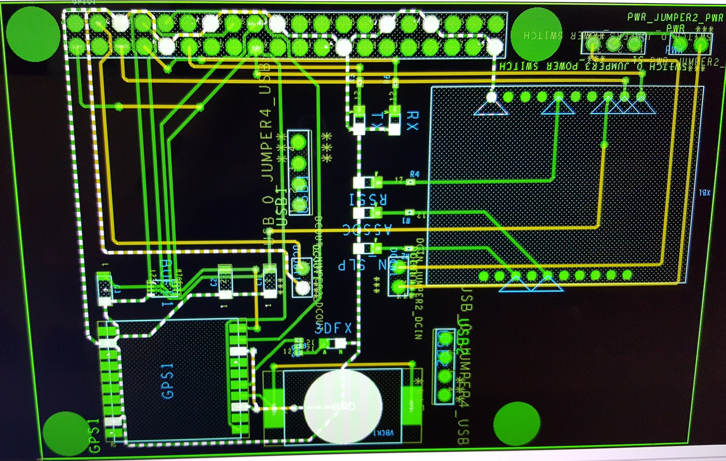
PCB
40 pin GPIO for RPi 3
Xbee 900hp
GPS Module
2x SDRs
6x LEDs
Backup Battery Holder
4x Mounting Holes
Notes:
ACL

Slide 30
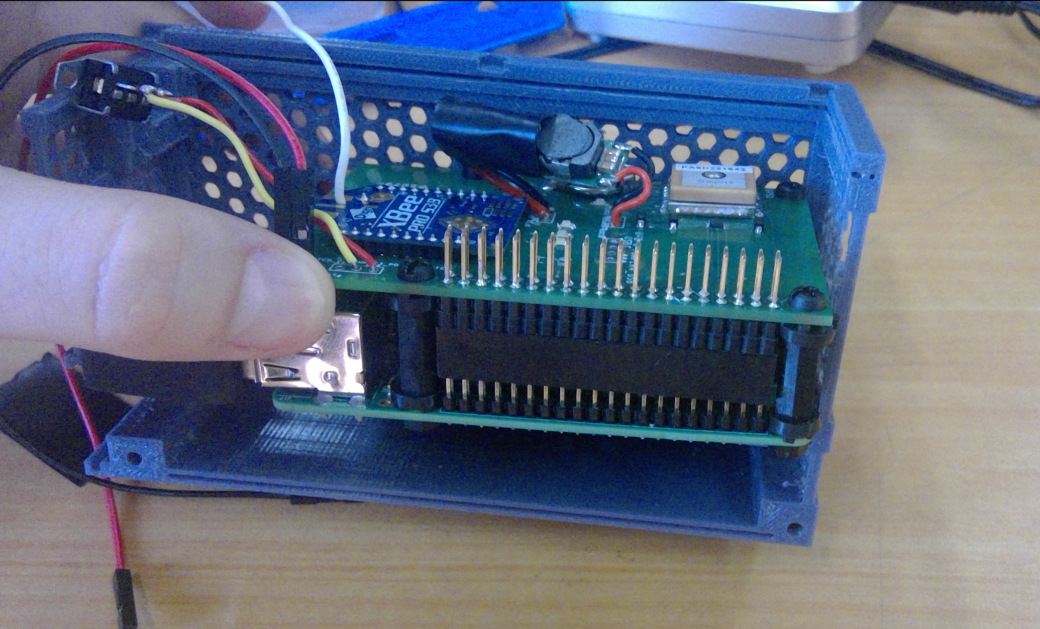
PCB - Stacked

Slide 31
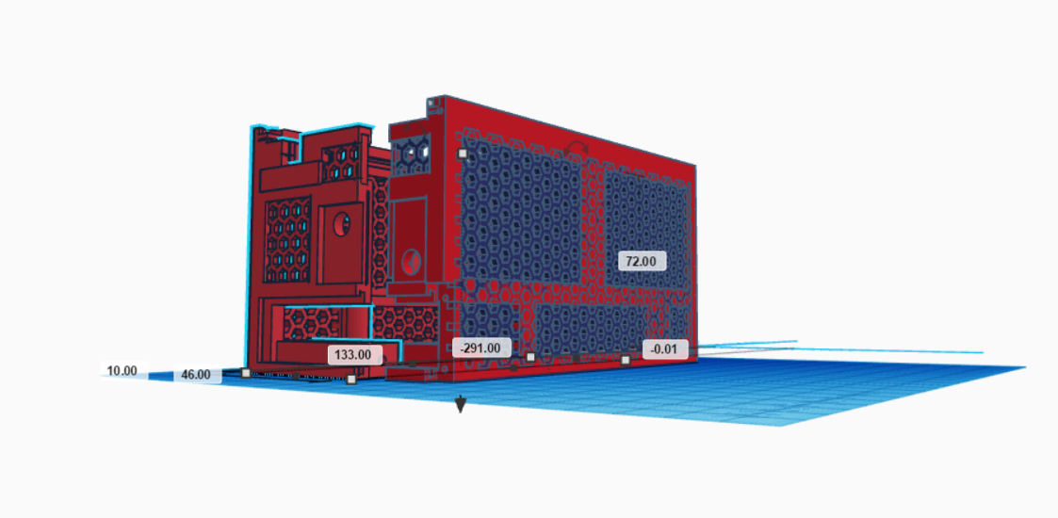
Packaging

Slide 32
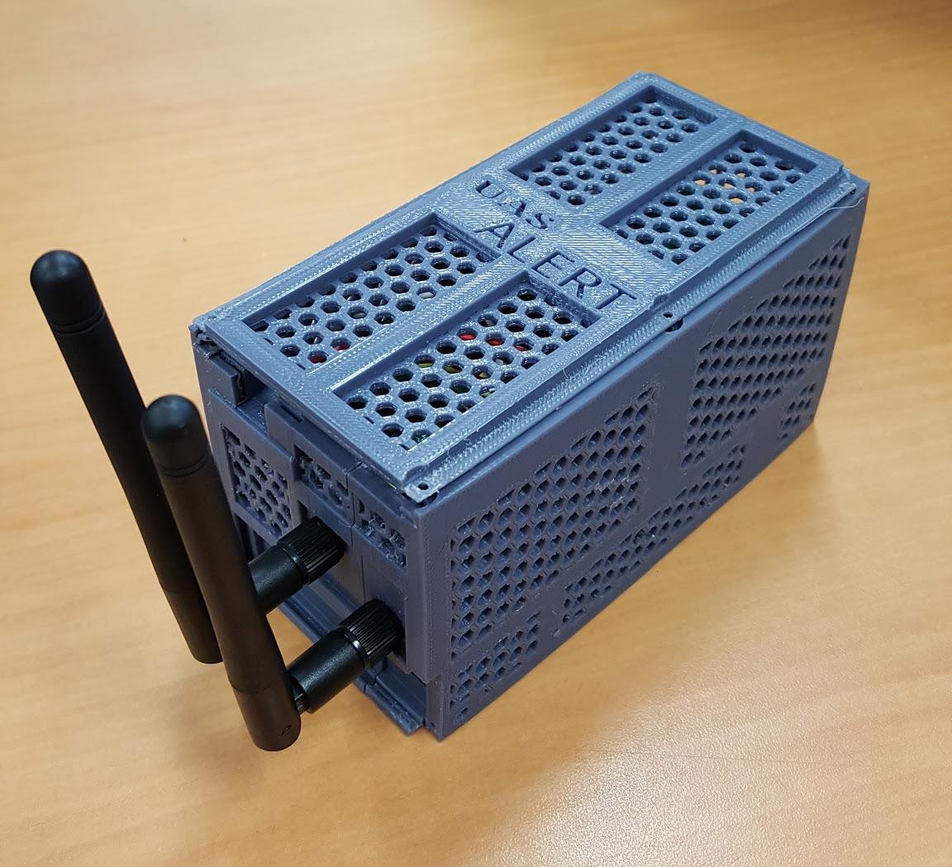
Packaging

Slide 33
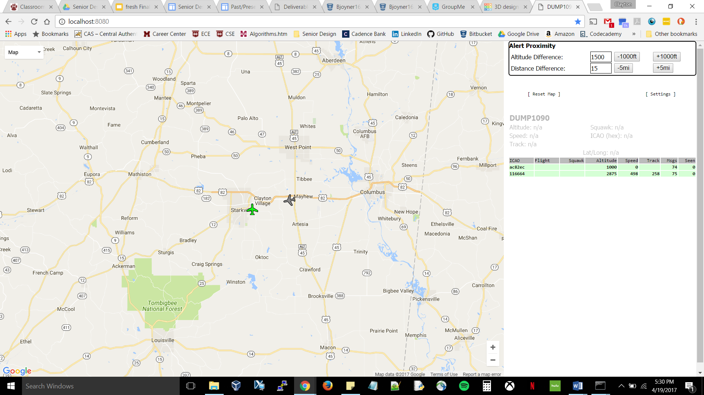
Ground Station Display
Notes:
Clayton Hudspeth starts here

Slide 34
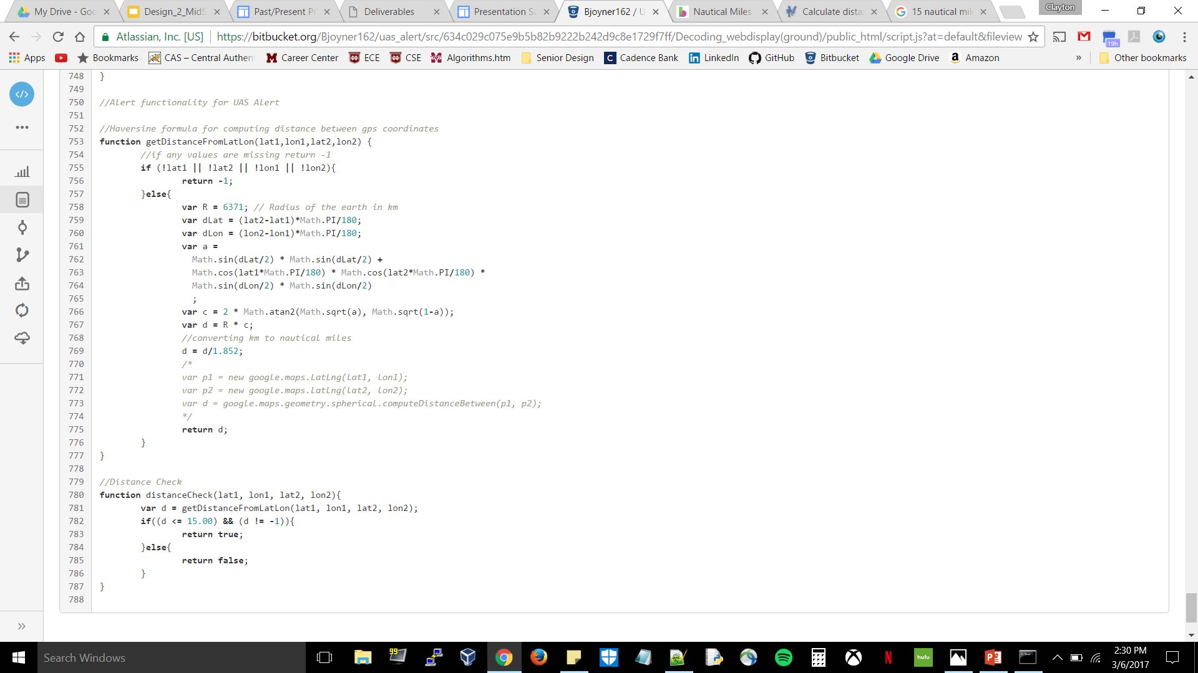
Ground Station Alerts
Haversine Formula used to calculate spherical distance between two coordinates
Code checks if coordinates and altitudes are less than set nautical miles and altitude distances

Slide 35
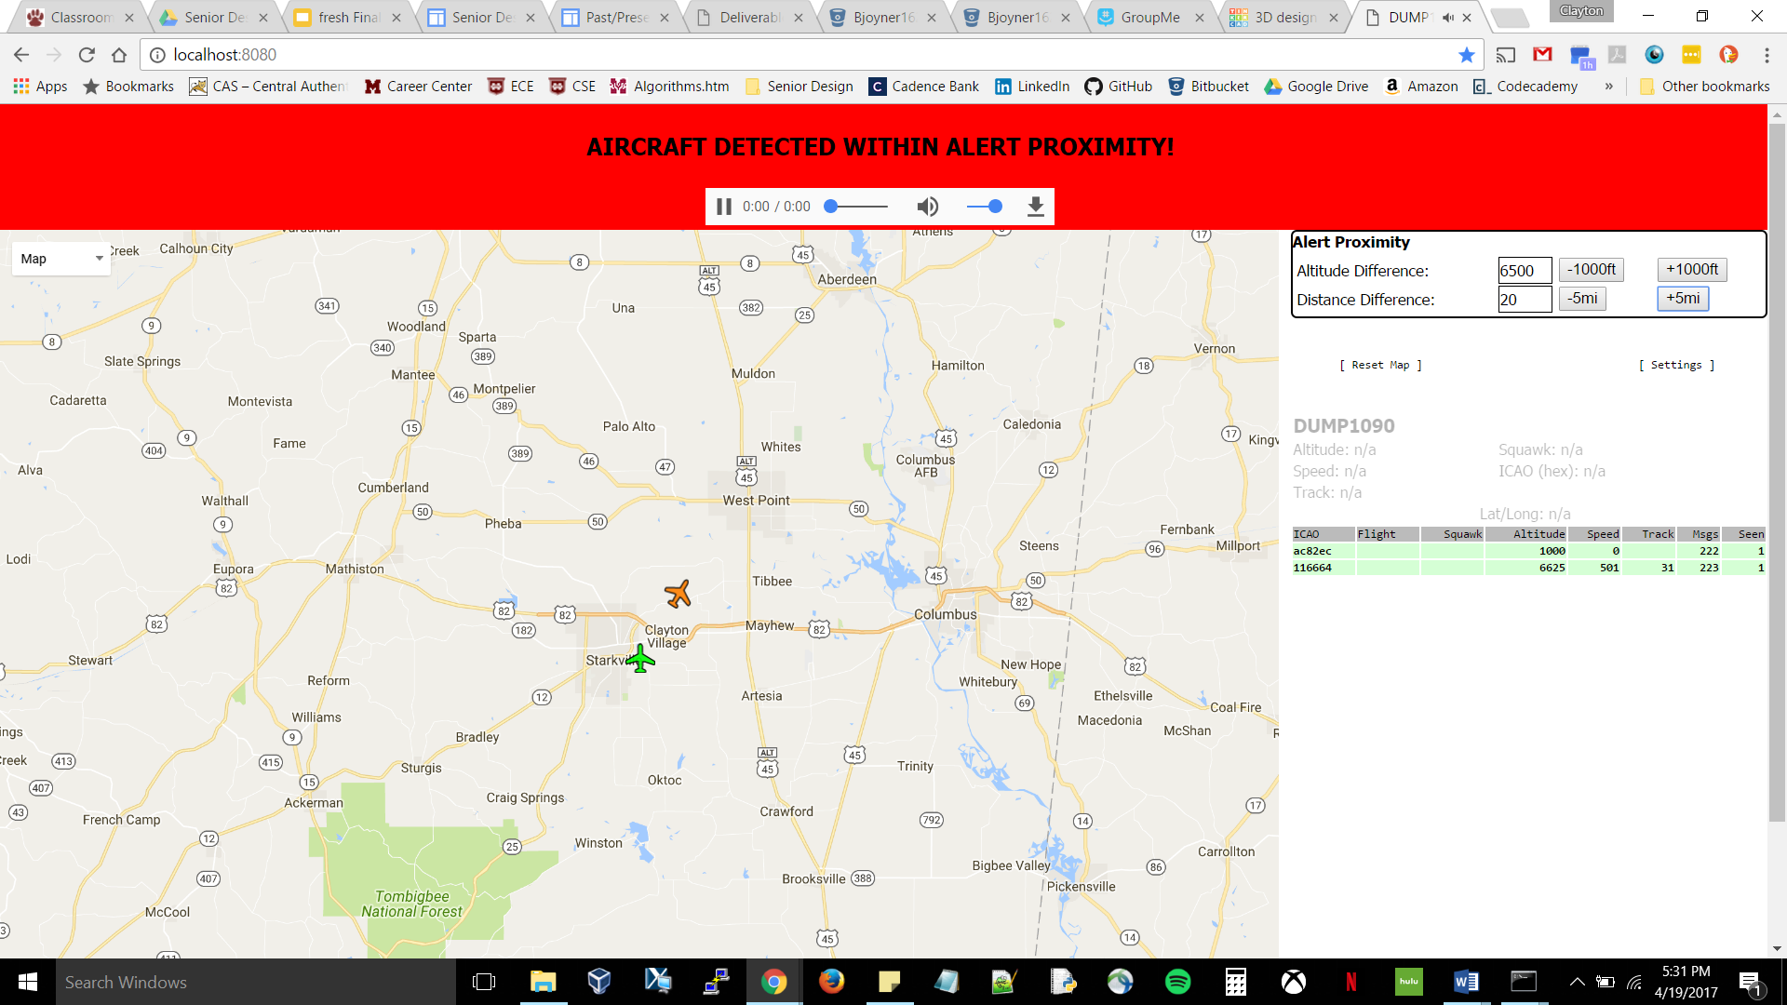
Ground Station Alerts

Slide 36
Ground
Station Alerts

Slide 37
Timeline

Slide 38
Timeline
 | January | February | March | April
PCB Design/Addition of GPS
Stress Testing/Packaging
Extra Features

Slide 39
Future Work

Slide 40
Future Work
3D-printed top for case using adhesive mounting

Slide 41
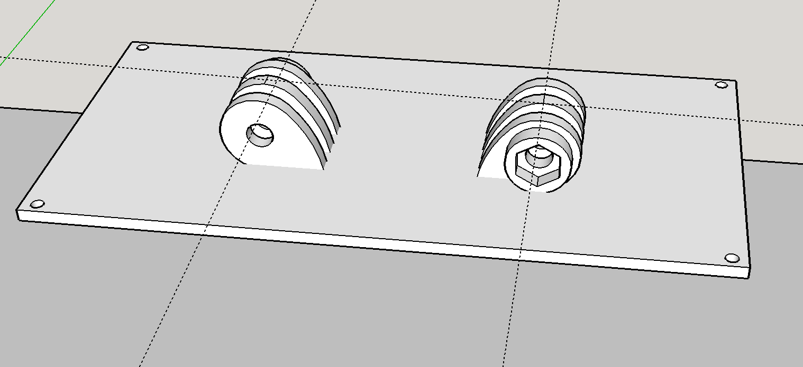
Packaging

Slide 42
Business Plan

Slide 43
Business Plan Summary
Objective:
Provide safer navigation for both aircraft and UAV operators by providing a display of surrounding aircraft to the UAV operator.
Will target both hobbyists and commercial industry
Basic Strategy:
Attend conventions targeted at UAV enthusiasts
New England Aviation Safety Expo
FAA UAS Symposium
Establish virtual store-front using Amazon.com

Slide 44
Business Plan Summary
Competitive Comparison:
UAS Alert is attachable to any UAV that the device can fit onto, unlike other products that require a specific flight controller for a specific UAV
Can easily be moved from one UAV to another
Power source is provided in a rechargeable battery pack, eliminating the need to pull power from the UAV battery

Slide 45
References
[1] "A320 collision heightens UAV safety concerns", Flightglobal.com, 2016. [Online]. Available: https://www.flightglobal.com/news/articles/a320-collision-heightens-uav-safety-concerns-424419/. [Accessed: 30- Aug- 2016].
[2] D. A. R. Reserved, "Phantom 3 standard," 2015. [Online]. Available: http://www.dji.com/phantom-3-standard/info#specs. Accessed: Nov. 10, 2016.
[3] "Realtek", Realtek.com.tw, 2016. [Online]. Available: http://www.realtek.com.tw/products/productsView.aspx?Langid=1&PFid=35&Level=4&Conn=3&ProdID=257. [Accessed: 06- Oct- 2016].

Slide 46
Questions?

